Slide 1

ABC CALL VOLUME TREND ANALYSIS
SWAGATIKA SAMAL

Slide 2

AGENDA
Introduction
Tech Stack Used
About Dataset
Questionnaire
Approach
Conclusion

Slide 3

INTRODUCTION

Slide 4
Welcome to call center volume analysis—a critical aspect of modern customer service management. Within the dynamic realm of call centers, understanding and effectively managing call volume is essential for delivering exceptional customer experiences and optimizing operational efficiency.
Call center volume analysis involves dissecting incoming call traffic patterns, identifying peak hours, and exploring seasonal variations to ensure seamless service delivery. By leveraging data analytics, organizations can uncover valuable insights into customer behavior and resource allocation needs.
Throughout this exploration, we'll delve into methodologies and best practices for historical data analysis, forecasting future call volumes, and enhancing operational efficiency. Join us as we uncover the secrets hidden within call center data, empowering organizations to thrive in today's customer-centric landscape. Let's dive in!

Slide 5
TECH STACK USED

Slide 6
Microsoft Excel
Microsoft Power Point

Slide 7
ABOUT DATASET

Slide 8
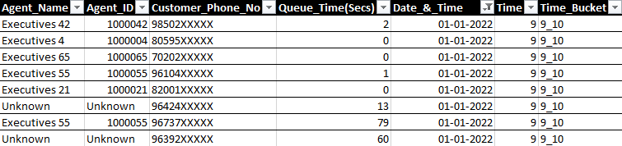
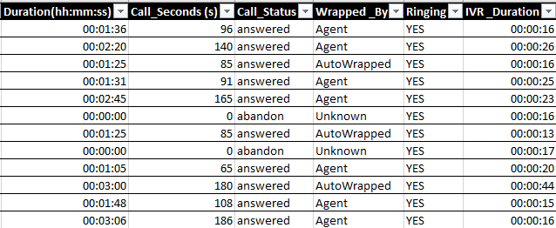
Dataset Description and its Screenshot
I received a dataset covering a period of 23 days, containing diverse information including the agent's name and ID, queue time (the duration customers waited before connecting with an agent), call timestamps, call durations, and call status (indicating whether it was abandoned, answered, or transferred).
Then I cleaned the dataset by imputing null values in agent_name, agent_id & wrapped_by to ‘unknown’.
Also I formatted the date_&_time column to required date format.

Slide 9
QUESTIONAIRRE & APPROACH

Slide 10
Average Call Duration: Determine the average duration of all incoming calls received by agents. This should be calculated for each time bucket.
First,I created a pivot table to calculate average of call seconds in each time bucket.
Then I plotted a bar graph for the same.
Here, we can see 1PM-7PM is the peak hours with more number of calls received.
We can also observe 4PM-5PM is the peak hour with average call seconds equals to 181.44s.

Slide 11
Call Volume Analysis: Visualize the total number of calls received. Time should be represented in buckets (e.g., 1-2, 2-3, etc.).
First,I created a pivot table to calculate number of calls received according to call status in each time bucket.
Then I plotted a line graph for the same.
Maximum calls are answered during the daytime and declines as it approaches evening i.e after 6PM
Also more calls have been abandoned till 1PM and then after 8PM

Slide 12
Manpower Planning: The current rate of abandoned calls is approximately 30%. Propose a plan for manpower allocation during each time bucket (from 9 am to 9 pm) to reduce the abandon rate to 10%.
First,I created a pivot table to calculate sum of call seconds in each time bucket on a single day
Then with that data I converted callseconds to call hours.
As provided total working hour of each agent is 60% of 7.5hrs which equals 4.5hrs
Finally I was able to find out the number of agents required to answer 90% of calls in a day.

Slide 13
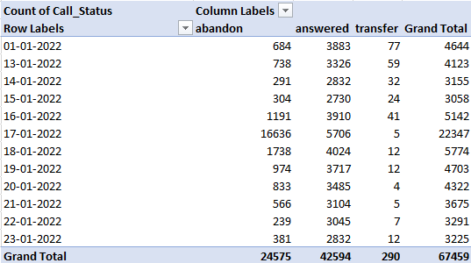

Night Shift Manpower Planning: Propose a manpower plan for each time bucket throughout night, keeping the maximum abandon rate at 10%.
Assumptions: An agent works for 6 days a week; On average, each agent takes 4 unplanned leaves per month; An agent's total working hours are 9 hours, out of which 1.5 hours are spent on lunch and snacks in the office. On average, an agent spends 60% of their total actual working hours (i.e., 60% of 7.5 hours) on calls with customers/users. The total number of days in a month is 30.
Calculations are done based on the above assumption. Average number of calls at night equals to 30 percent of average calls during daytime.

Slide 14
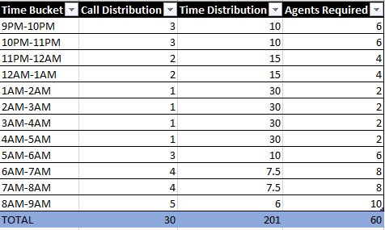
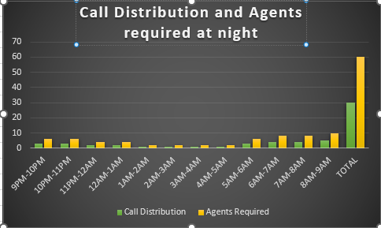
Night Shift Manpower Planning: Bar Graph representation

Slide 15
CONCLUSION

Slide 16
In conclusion, this project has provided me with invaluable insights into the significance of Data Analytics in Customer Experience Analysis, emphasizing its role in facilitating informed, data-driven decision-making processes.
Throughout this project, I gained insights into various aspects such as call abandon rates, distribution of call durations, call volumes, and agent allocation strategies aimed at reducing abandoned calls. Additionally, I acquired practical experience in Data Preprocessing techniques including Data Cleaning, handling Outliers, and Feature Engineering, enhancing my proficiency in preparing data for analysis.
Moreover, I am now equipped to effectively communicate these insights to relevant stakeholders as per their requirements, thereby fostering informed discussions and strategic actions.
Notably, the analysis revealed that the highest demand for agents occurs during the morning hours from 9 A.M to 1 P.M, while the lowest demand occurs during the night hours from 12 A.M to 5 A.M, highlighting key insights for optimizing manpower allocation across different time buckets.

Slide 17

THANK YOU

